Slide 1
Weather radar data processing: open source tools
Jordi Figueras i Ventura Pyrad course

Slide 2
Contents
Introduction
A typical radar data processing chain
Radar data file formats
Open source software packages

Slide 3
1. Introduction

Slide 4
What is Open Source Software ?
A software package is open source if :
Allows free (senza pagare) redistribution
Includes the source code (or it is easily accessible) and allows distribution of both compiled and source code.
Allows modifications and derived works, allows distributing them under the same terms as the licence of the original software
No discrimination against persons or groups
No discrimination against fields of use (e.g. business, genetic research)
No need for any other licence (appart from the one of the package) to use it
The licence is not specific to a product, software within a distribution can be used and distributed independently
The licence does not restrict the use of other software
The licence is technology-neutral
https://opensource.org

Slide 5
Open source for weather radar ?
Since the late 2000s (and even before) there has been a number of major open source projects released (see e.g. https://openradarscience.org).
Some of them are in a mature stage and are widely used in an academic (mostly) but also operational environment
Most make use of modern tools (e.g. github, conda, docker) and practices (e.g. Continuous Integration, automatic tests) that make them easy to evolve and deploy
Most are backed by major weather services or academic institutions
Projects are not competing among them but collaborating : Best practices and inter-operability are discussed regularly and joint open source courses have been organized for years at major radar conferences (AMS, ERAD)

Slide 6
The weather radar business
Metadata generation
Beam blockage
Scattering simulations
PSDs
Calibration/monitoring
Solar monitoring
Sphere calibration
Inter-comparison
Severe weather alarms
radar/RG merging
Forest fires
Hydrological models
Bird/insect migration prediction
Radar-derived products
Precipitation Nowcasting
Assimilation in NWP models
Storm tracking
VAD
3D winds
Bird/insect migration detection
VIL
Zmax
Echo top
Ground QPE
PoH
Mesh
Radar-based products
QVP
VPR
ML detection
1D/2D/3D Compositing
RR
LWC
hydro-class
Gate-based products
Moment correction
Clutter removal
De-aliased Vr
KDP
Attenuation
IQ data processing
Raw Dual-pol/
Doppler moments
Radar control
Data visualization
Reading/Writing

Slide 7
The weather radar business
Metadata generation
Pyrad
Py-Tmatrix
PyDSD
Calibration/monitoring
Pyrad BALTRAD
LROSE
wradlib
wradlib
LROSE
PyBlock
LROSE
TINT
Radar-derived products
Pysteps
Rainymotion
wradlib
PyDDA
PyTDA
SingleDop
Rainforest
vol2bird
LROSE
BALTRAD
Pyrad
Py-ART
wradlib
Radar-based products
Pyrad
Py-ART
wradlib
LROSE
BALTRAD
1D/2D/3D Compositing
LROSE
BALTRAD
Gate-based products
Pyrad
Py-ART
wradlib
LROSE
BALTRAD
Moment correction
Pyrad
Py-ART
wradlib
IQ data processing
Pyrad
HighIQ
Radar control
Data visualization
Reading/Writing

Slide 8
2. A typical radar data processing chain

Slide 9
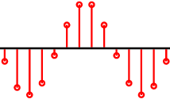
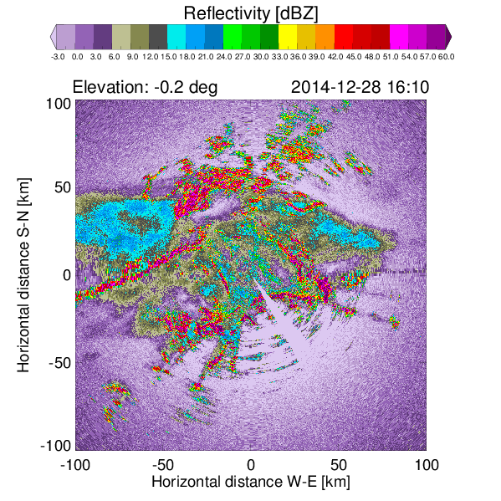
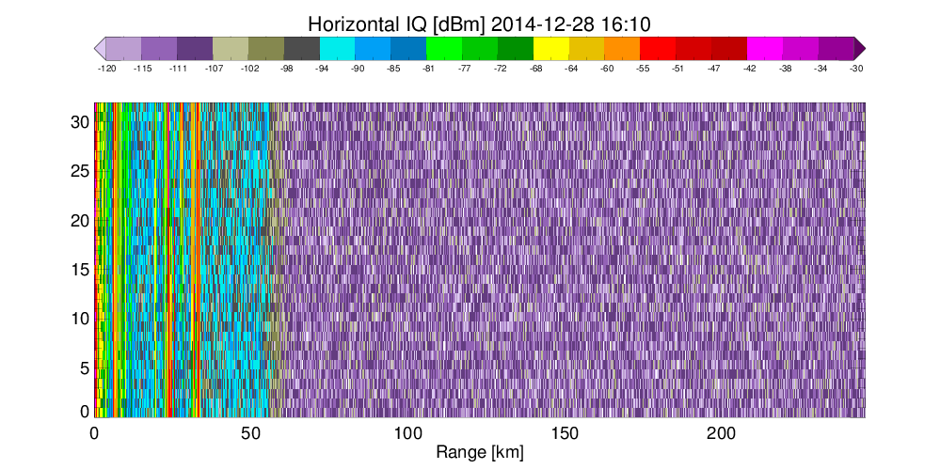
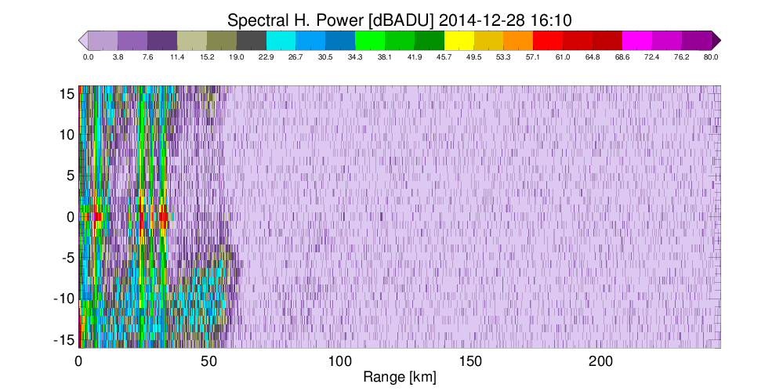
IQ data processing
Moment
Computation
Zh
Vr, WD
ZDR, PsiDP, RhoHV
Spectra
Moment
Computation

Slide 10
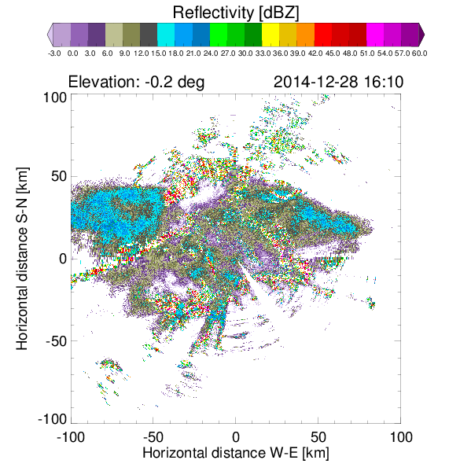
Moment correction
de-aliasing
Vdeal
WD_corr
PhiDP
processing
Zh_corr
ZDR_corr
PhiDP
KDP
Ah
Adp
Raw
moments
Noise & bias
Corr.
Clutter
Filtering
Vis. Corr.
Att. Corr.
ML detection
Iso-0° alt.

Slide 11
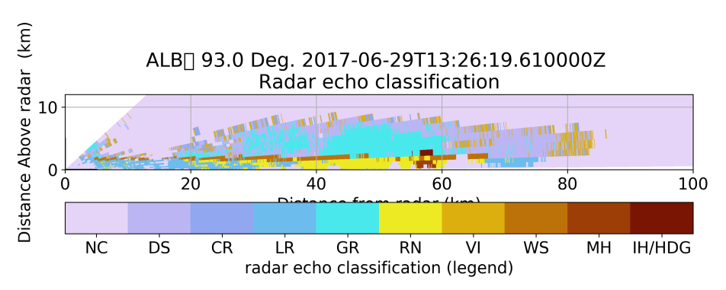
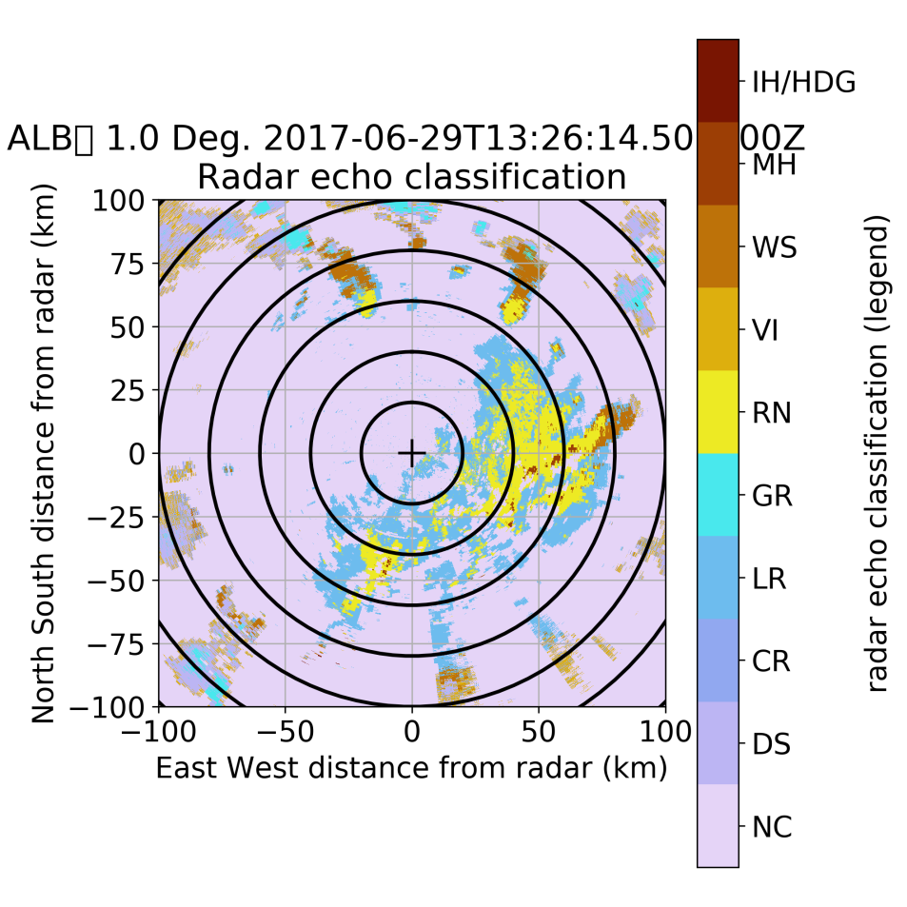
Gate-based products
Turbulence
Detect.
Turbulence
Wind
estimate
u,v,w
VPR corr.
Processed
moments
Iso-0° alt.
RR retrieval
eRR
hydroclass
Hydro.
Class.

Slide 12
Radar-based products
eRR
3D grid
mapping
Level
Extract.
Accumul.
Raccu
RR
Vdeal
3D grid
mapping
3D-winds
Zh
3D grid
mapping
Hail ID
PoH
MESH
Iso-0° alt.
And many more!!!
Forest fire detection
Meteorite detection
Bird detection
Storm tracking
...
Processed
Pol. Mom.
QVP
Pol. Data
TS
Vdeal
VAD
Wind TS

Slide 13
3. Radar data file formats

Slide 14
Radar Data Formats
Radar data takes different formats at each processing stage:
IQ data: Time series of complex numbers
Moments: Polar coordinates (azimuth, elevation, range)
Composites: Cartesian/geo-referenced grids
Radar-based products: Grids but also time-height, time-range, etc.
Radar-derived products: ??????
There is no formally accepted standard yet for radar data at any stage
Most radar manufacturers and major Met services use their own proprietary formats
There are 3 de-facto standards for moment data file formats:
ODIM_H5
CfRadial
NEXRAD-AR2

Slide 15
CfRadial
NetCDF Climate and forecast (CF) Conventions for RADAR and LIDAR data in polar coordinates
Based on Network Common Data Form (NetCDF)
Maintained by NCAR
De-facto standard for the research community
Two major versions:
CfRadial Version 1: (Since 2010) Classic model using NetCDF3 =>
Data stored in regular 2D (time, range) format
Metadata: range, time, elevation, azimuth, (ray_n_gates, ray_start_index)
CfRadial version 2: (Since 2016) uses NetCDF4 (based on HDF5) and groups
Hierarchical grouping volume=>sweep=>dataset (time, range)
Candidate for WMO radar data standard (FM301)
Readers: wradlib, BALTRAD, Py-ART (V1), LROSE, Pyrad (V1 and (partially) V2)
Py-ART data model
https://ncar.github.io/CfRadial/

Slide 16
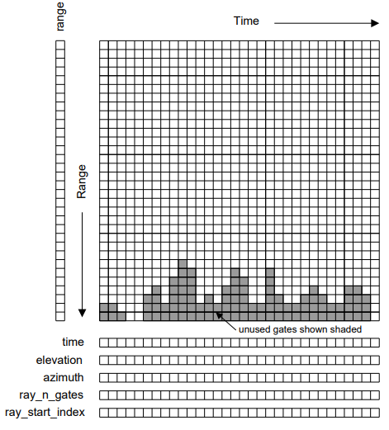
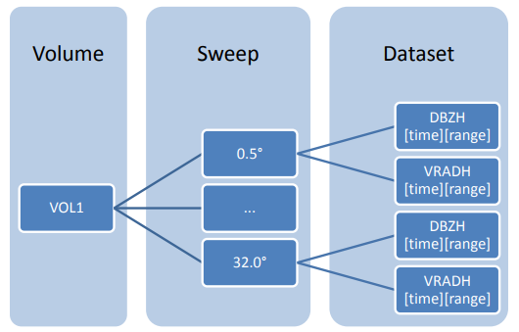
CFRadial
CFRadial 1
CFRadial 2

Slide 17
ODIM_H5
OPERA Data Information Model for HDF5
Based on HDF5
Maintained by the OPERA programme of EUMETNET
European standard for the exchange of radar data
Defined for exchange of polar AND Cartesian data
Uses groups
Readers: wradlib, Py-ART, Pyrad, BALTRAD, LROSE

Slide 18
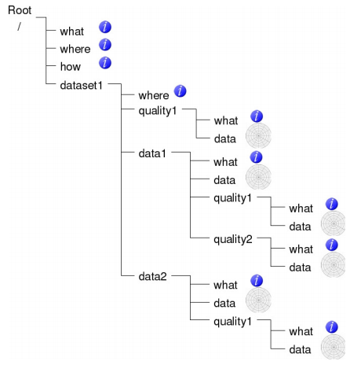
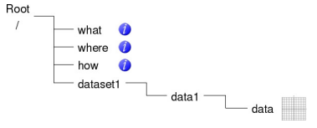
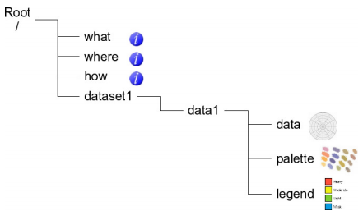
ODIM

Slide 19
NEXRAD-AR2 data
Data from the US Weather radar network
NEXRAD Level-II (Base) Data: reflectivity, mean radial velocity, spectrum width, (differential reflectivity, correlation coefficient, differential phase)
NEXRAD Level-III Products: More than 75 products
Readers: wradlib, Py-ART, Pyrad (level II), LROSE

Slide 20
4. Open source software packages

Slide 21

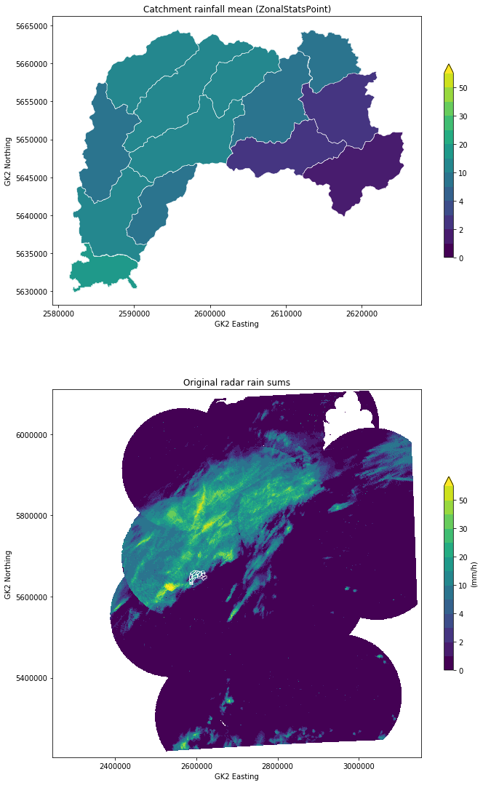
wradlib
Philosophy : Keep the magic to the minimum (and let the user decide)
One of the oldest packages (2011)
Open platform for collaborative development of algorithms
Python-based
Linux/Windows/Mac
Flat data model that allows maximum flexibility to interact with the data. xarray readers available
Comprehensively addresses the full radar processing chain
Mainly geared to interactive use in research but used in operations too
Easy to install (PyPI, conda, Docker Hub)
https://wradlib.org

Slide 22
Wradlib functionality
Module | Functionality | Comments
adjust | Gage adjustment
atten | Attenuation Correction | Hitschfeld, PIA from KDP
classify | Hydrometeor Classification | Fuzzy logic classifier
clutter | Clutter Identification
comp | Composition | Multiple Radar compositing
dp | Dual-Pol and Differential Phase | KDP retrieval, texture computation, de-polarization ratio computation
georef | Georeferencing
io | Raw data I/O | Many readers, some put data in xarrays
ipol | Interpolation | Interpolation functions
qual | Data Quality | Beam blockage calculations, Bright band contamination
trafo | Data Transformation | e.g. linear to dB
util | Utility Functions | Despeckle, derivate, etc.
verify | Verification | Comparison between radar-base precipitation and ground truth
vis | Visualization | PPI, RHI, etc.
vpr | Vertical Profile of Reflectivity | Create and work with 3D grids
zonalstats | Zonal Statistics
zr | Z-R Conversions

Slide 23




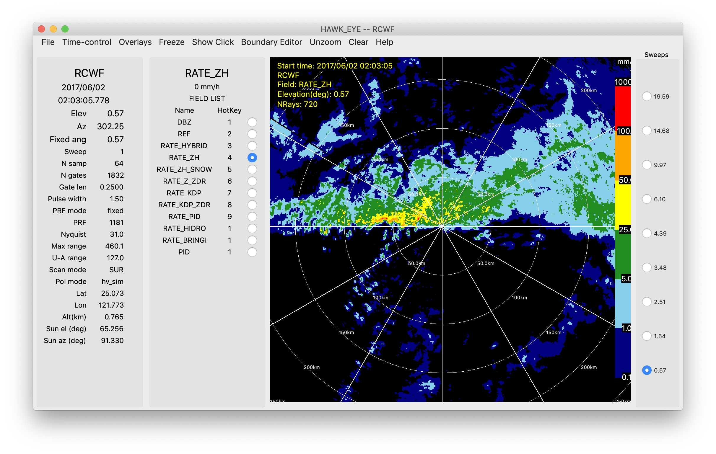
LROSE
Philosophy : High quality building blocks for complex workflows
Based on legacy of NCAR and CSU tools
Fast native cross-platform applications
Mostly C++
Linux/Mac/partially Windows
Many stand-alone tools
Stores data in CF/Radial
http://lrose.net/

Slide 24
LROSE tools
Convert | RadxPrint: Print file properties and determine if it is supported by Radx RadxConvert and RadxBufr: Conversion from 25 formats to CfRadial
Display | HawkEye
Quality Control | 14 tools: compare merge and filter fields Detect sun hits and analyse them
Grid | Radx2Grid
Echo | 23 tools: KDP and Attenuation Particle Identification, hydrometeor classification Rain rate and rainfall accumulation Beam blockage estimation Convective/stratiform Mesocyclones Refractivity and moisture Titan (Thunderstorm Identification, Tracking, Analysis and Nowcasting)
Wind | 5 tools: VAD Multi-Doppler retrieval Vortex Optical Flow

Slide 25

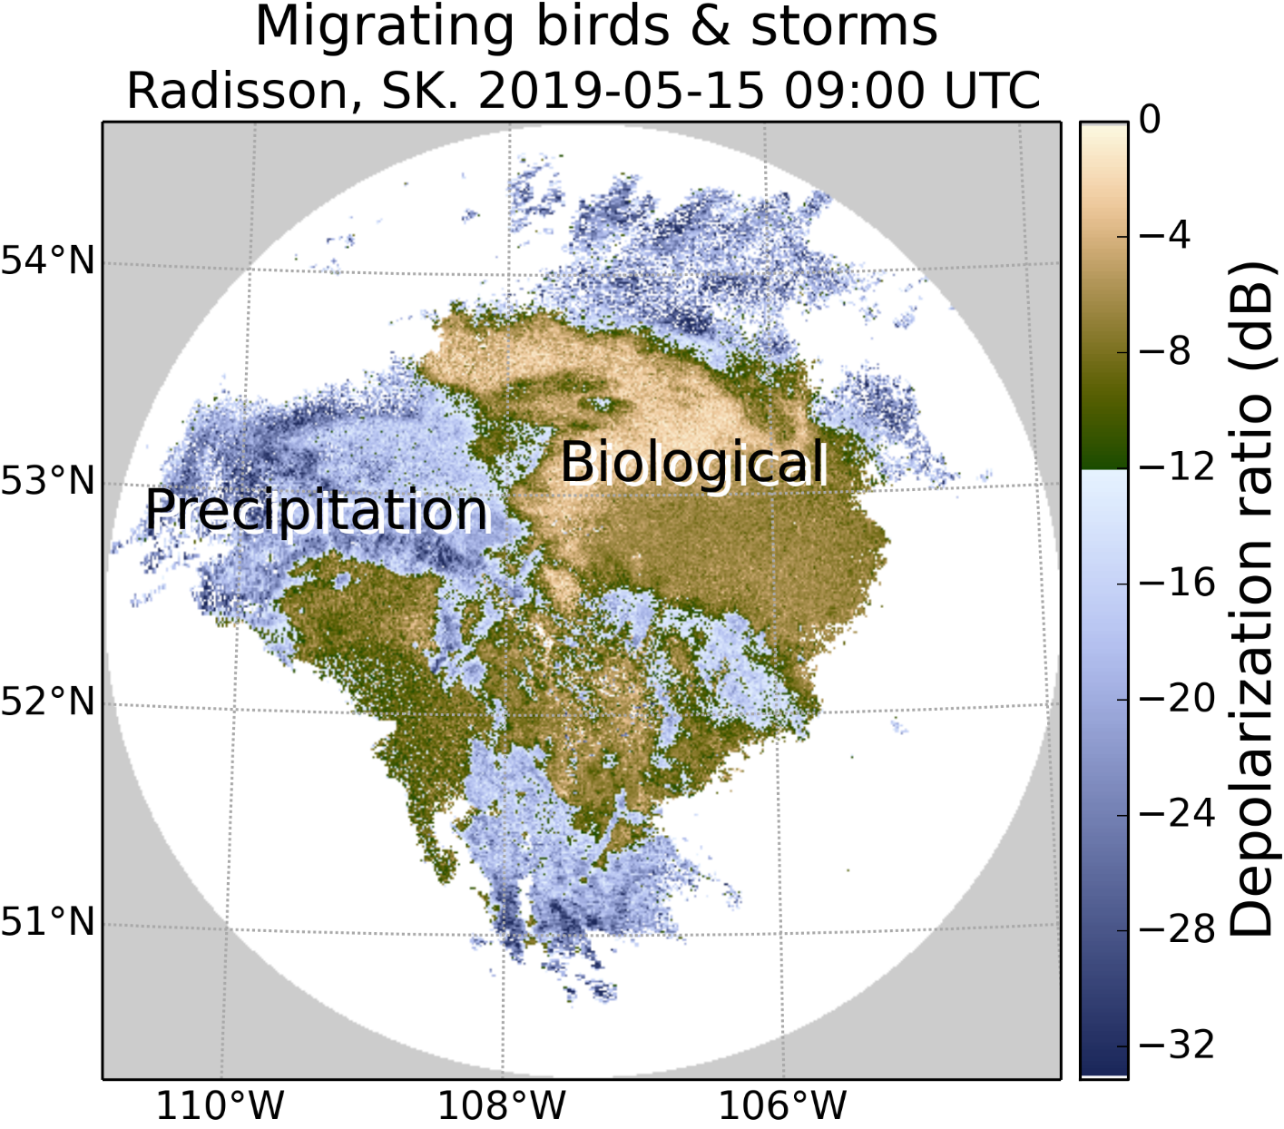
BALTRAD
Philosophy : Advanced Weather Radar Network
Heritage from the Nordic Network NORDRAD. Partly funded by the EU. BALTRAD and BALTRAD+ projects (2009-2014). 13 partners in 10 countries
Real-time data exchange and data processing
Sub-packages written in different languages
Data exchange: JAVA
Data processing: C and Python
Linux/Mac
Distributed networking, partners exchange polar
data and process them using a common toolbox
Uses ODIM-H5
Docu: https://baltrad.github.io/
Code: https://github.com/baltrad

Slide 26
BALTRAD packages
Package | Environment | Description
baltrad-db | Python, Java | Database manager subsystem
BaltradDex | Java | Distribution and Exchange subsystem
baltrad_wms | OGC Map Server | Web map services
bbufr | C, Python | BALTRAD interface to EUMETNET OPERA’s BUFR Software
beamb | C, Python | Beam blockage correction
beast | Java | Task manager/scheduler subsystem
bRopo | C, Python | Anomaly (non-precipitation echo) detection and removal
GoogleMapsPlugin | Python | Creation of PNG images to use in Google Maps
node-installer | Python | Installation wizard
OdimH5 | Java | Data injector using ODIM_H5 and Rainbow file formats
RAVE | C, Python | Product generation framework and toolbox
baltrad_wrwp | C, Python | Wind products
baltrad-ppc | C, Python | Polarimetric processing chain

Slide 27
Other useful meteorological software
Py-TROLL : satellite data processing
WRF: weather Research and Forecasting Model
MetPy: weather data visualization
Metview: Meteorological workstation
MetWork Framework: Useful modules to build meteorological applications

Slide 28
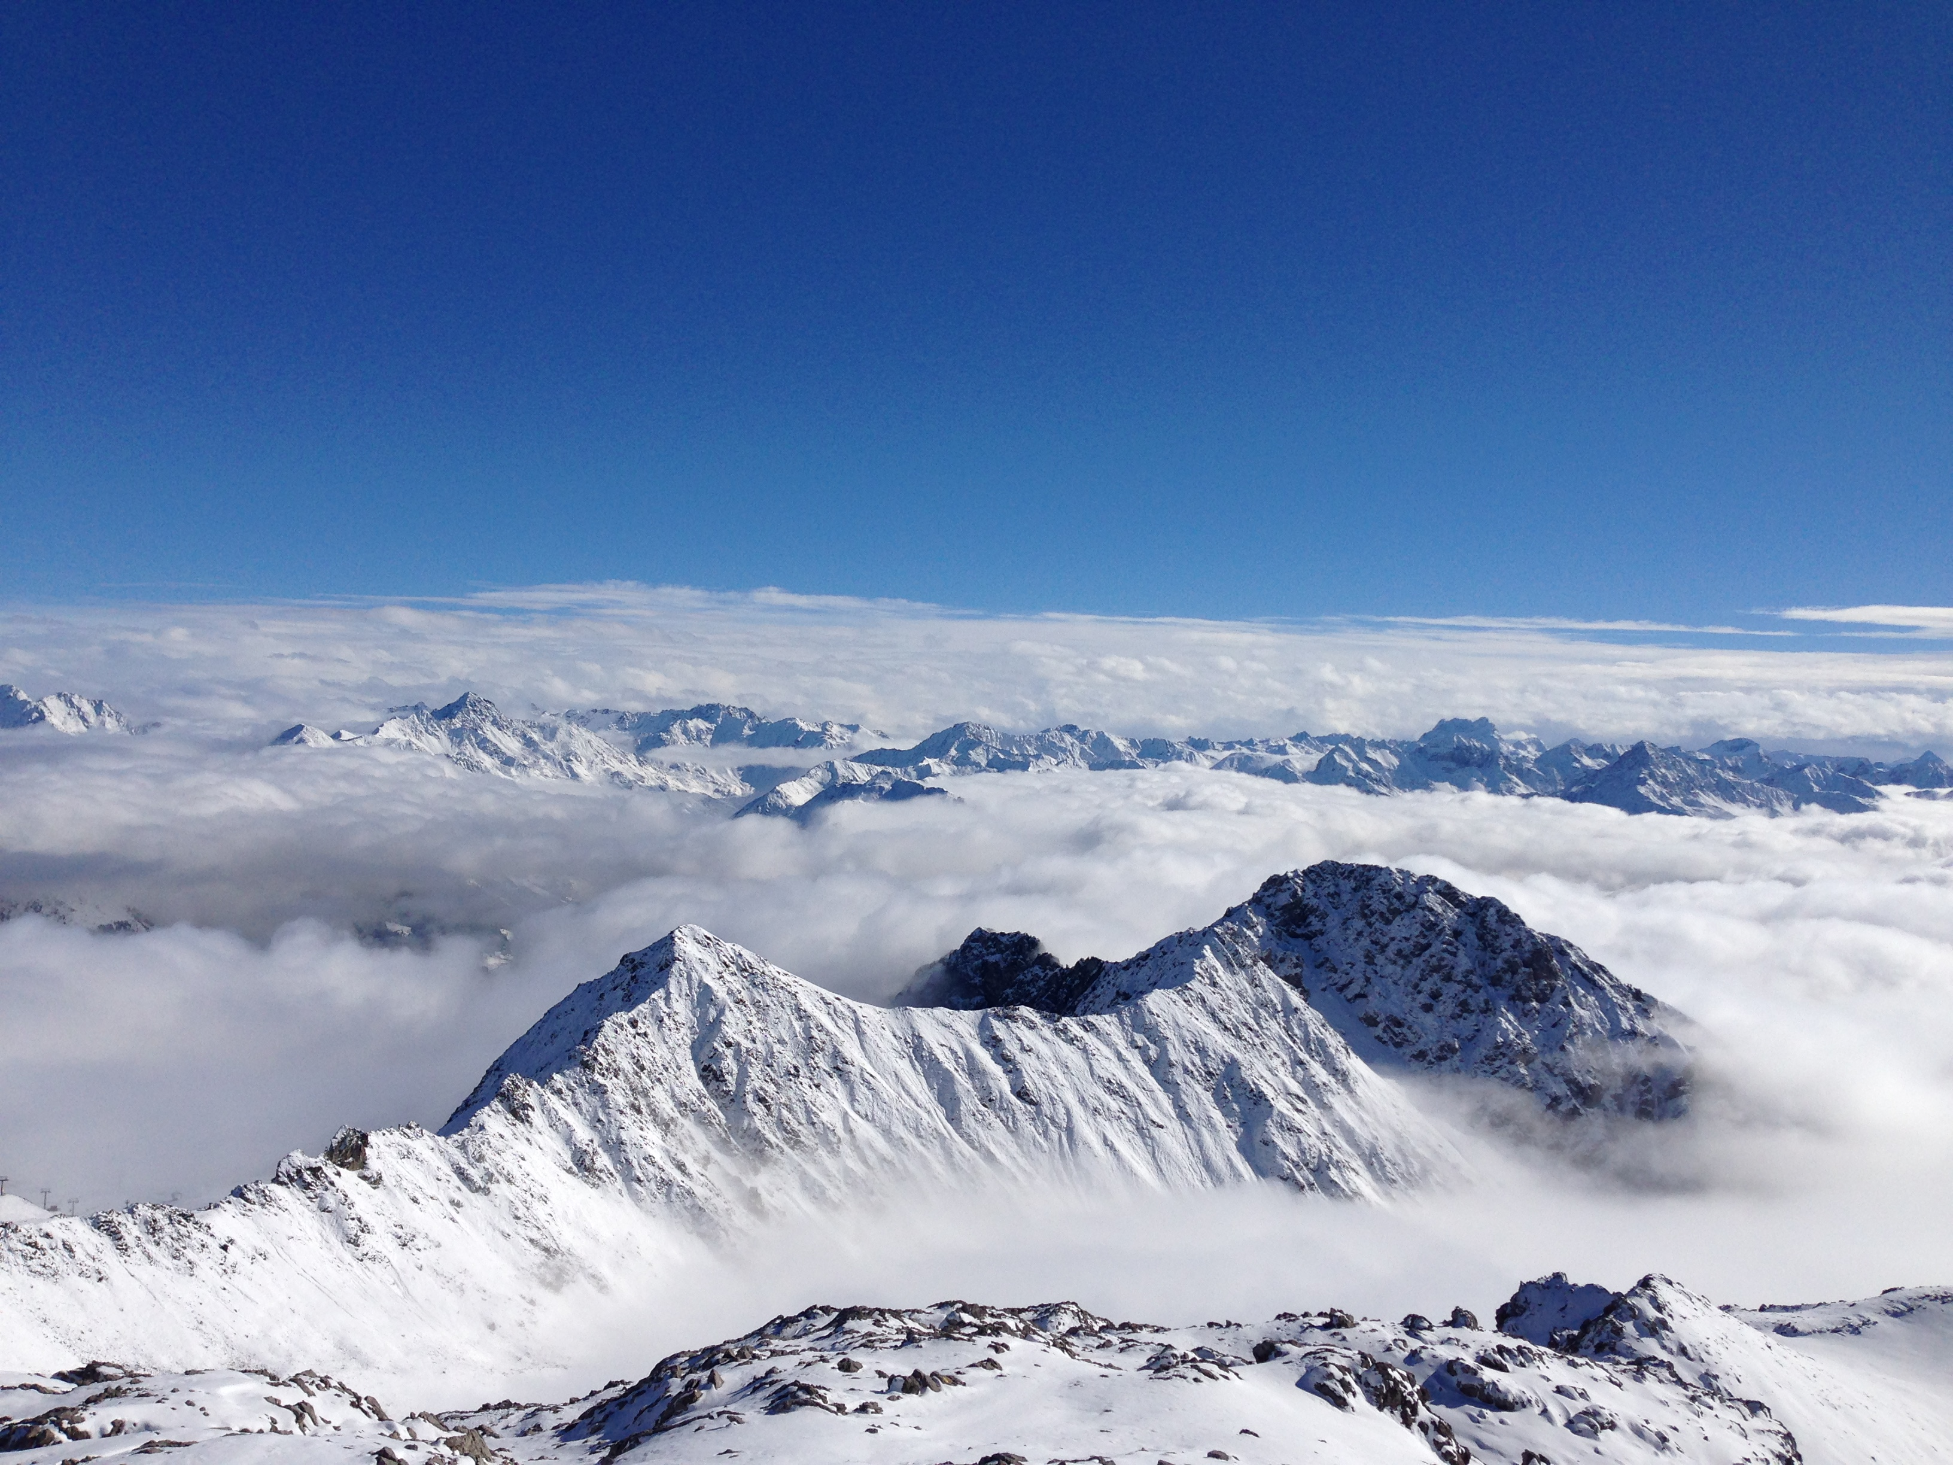
GRAZIE !
MERCI!
THANK YOU !
GRÀCIES!

